Slide 1
Course Outline
Introduction and Algorithm Analysis (Ch. 2)
Hash Tables: dictionary data structure (Ch. 5)
Heaps: priority queue data structures (Ch. 6)
Balanced Search Trees: general search structures (Ch. 4.1-4.5)
Union-Find data structure (Ch. 8.1–8.5)
Graphs: Representations and basic algorithms
  Topological Sort (Ch. 9.1-9.2)
  Minimum spanning trees (Ch. 9.5)
  Shortest-path algorithms (Ch. 9.3.2)
B-Trees: External-Memory data structures (Ch. 4.7)
kD-Trees: Multi-Dimensional data structures (Ch. 12.6)
Misc.: Streaming data, randomization

Slide 2
Disjoint set ADT (also Dynamic Equivalence)
The universe consists of n elements,
named 1, 2, …, n
The ADT is a collection of sets of elements
Each element is in exactly one set
    sets are disjoint
    to start, each set contains one element
Each set has a name, which is
the name of one of its elements
(any one will do)

Slide 3
Disjoint set ADT, continued
Setname = find ( elementname )
  returns the name of the unique set that
  contains the given element
  not the same as “find” in search trees
  (lousy terminology, for historical reasons…)
union ( Setname1, Setname2 )
  replaces both sets with a new set
  the name of the new set is not specified
Analysis: worst-case total running time
of a sequence of f finds and u unions

Slide 4
Toy application: mazes without loops
1
2
3
4
5
1
2
3
4
5
6
7
8
9
10
6
7
8
9
10
11
12
13
14
15
11
12
13
14
15
16
17
18
19
20
16
17
18
19
20
21
22
23
24
25
21
22
23
24
25
elements are 1, 2, … 25; sets are connected parts of the maze
start with each element in its own set;
repeat {
pick two adjacent elements p and q (= p ± 1 or p ± 5) at random;
if (psetname = find(p)) != (qsetname = find(q)) { erase the wall between p and q;
union(psetname, qsetname);
}
} until 24 walls have been erased

Slide 5
First Try: Quick Find
Array implementation. Items are 1, …, N
Setname[i] = name of the set containing item I
Find : O(1), Union : O(N)
u Union, f Find operations: O(u*N+f )
N-1 Unions and O(N) Finds: O(N²) total time
Initialize(int N)
Setname = new int [N+1];
for (int e=1; e<=N; e++)
Setname[e] = e;
Union(int i, int j)
for (int k=1; k<=N; k++)
if (Setname[k] == j)
Setname[k] = i;
int Find(int e)
return Setname[e];

Slide 6
Union(5,11)
Union(12,4)
Union(1,5)
Union(15,1)
1
2
3
4
5
6
7
8
9
10
11
12
13
14
15
16
1
1
2
3
4
5
6
7
8
9
10
11
12
13
14
15
16
1
1
2
3
4
5
6
7
8
9
10
11
12
13
14
15
16
1
1
2
3
4
5
6
7
8
9
10
11
12
13
14
15
16
1
1
2
3
4
5
6
7
8
9
10
11
12
13
14
15
16
15
2
2
2
2
2
3
3
3
3
3
4
4
12
12
12
5
5
5
1
15
6
6
6
6
6
7
7
7
7
7
8
8
8
8
8
9
9
9
9
9
10
10
10
10
10
11
5
5
1
15
12
12
12
12
12
13
13
13
13
13
14
14
14
14
14
15
15
15
15
15
16
16
16
16
16

Slide 7
Quick Find Analysis
Find : O(1), Union : O(N)
u Union, f Find operations: O(u*N+f )
N-1 Unions and O(N) Finds: O(N²) total time

Slide 8
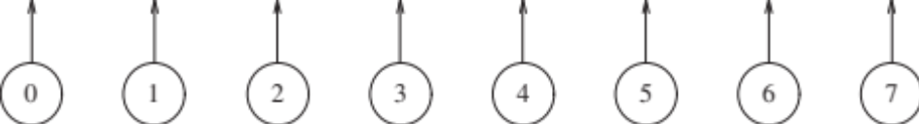
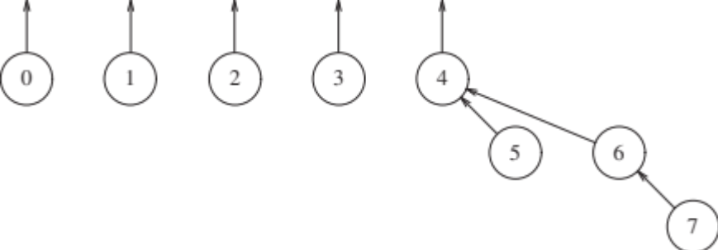
Quick Union: Tree implementation
Each set a tree: Root serves as SetName
  To Find, follow parent pointers to the root
  Initially parent pointers set to self
  To union(u,v), make v’s parent point to u
After union(4,5), union(6,7), union(4,6)

Slide 9
Analysis of Quick Union
Initialize(int N)
parent = new int [N+1];
for (int e=1; e<=N; e++)
parent[e] = 0;
int Find(int e)
while (parent[e] != 0)
e = parent[e];
return e;
Union(int i, int j)
parent[j] = i;
Union(N-1, N);
Union(N-2, N-1);
Union(N-3, N-2);
…
Union(1, 2);
Find(1);
Find(2);
…
Find(N);
1
2
3
N−1
N
Complexity in the worst case:
  Union is O(1) but Find is O(n)
  u Union, f Find : O(u + f n)
  N-1 Unions and O(N) Finds: still O(N²) total time

Slide 10
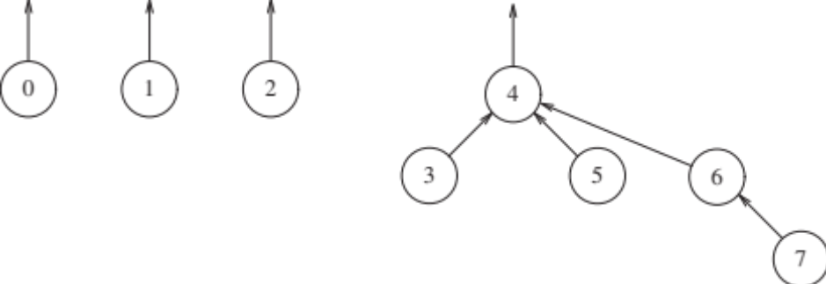
Smart Union (or Union by Size)
union(u,v): make smaller tree point to bigger one’s root
That is, make v’s root point to u if v’s tree is smaller.
Union(4,5), union(6,7), union(4,6) .
Now perform union(3, 4). Smaller tree made the child node.

Slide 11
Union by Size: link smaller tree to larger one
Initialize(int N)
setsize = new int[N+1];
parent = new int [N+1];
for (int e=1; e <= N; e++)
parent[e] = 0;
setsize[e] = 1;
int Find(int e)
while (parent[e] != 0)
e = parent[e];
return e;
Union(int i, int j)
if setsize[i] < setsize[j]
then
setsize[j] += setsize[i];
parent[i] = j;
else
setsize[i] += setsize[j];
parent[j] = i ;
Lemma: After n union ops, the tree height is at most log n.

Slide 12
Union by Size: Analysis
Find(u) takes time proportional to u’s depth in its tree.
Show that if u’s depth is h, then its tree has at least 2^{h} nodes.
When union(u,v) performed, the depth of u only increases if its root becomes the child of v.
  That only happens if v’s tree is larger than u’s tree.
If u’s depth grows by 1, its (new) treeSize is > 2 * oldTreeSize
  Each increment in depth doubles the size of u’s tree.
  After n union operations, size is at most n, so depth at most log n.
Theorem: With Union-By-Size, we can do find in O(log n) time and union in O(1) time (assuming roots of u, v known).
N-1 Unions, O(N) Finds: O(N log N) total time

Slide 13
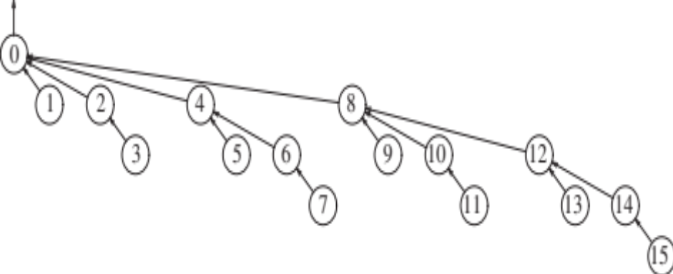
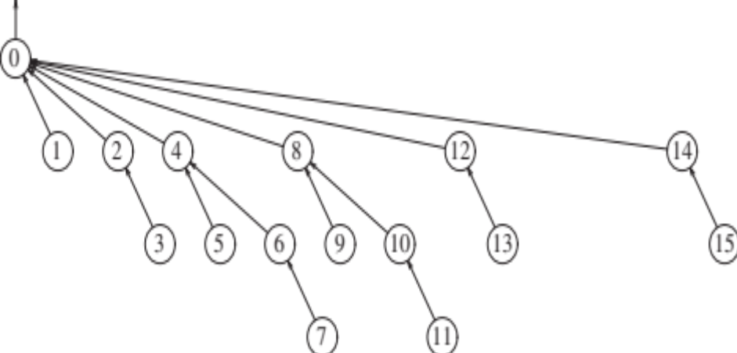
The Ultimate Union-Find: Path compression
int Find(int e)
if (parent[e] == 0)
return e
else
parent[e] = Find(parent[e])
return parent[e]
While performing Find, direct all nodes on the path to the root.
Example: Find(14)

Slide 14
The Ultimate Union-Find: Path compression
int Find(int e)
if (parent[e] == 0)
return e
else
parent[e] = Find(parent[e])
return parent[e]
Any single find can still be O(log N),
but later finds on the same path are faster
Analysis of UF with Path Compression a tour de force [Robert Tarjan]
u Unions, f Finds: O(u + f α(f, u))
α(f, u) is a functional inverse of Ackermann’s function
N-1 Unions, O(N) Finds: “almost linear” total time

Slide 15
A perspective on Inverse Ackermann
We are familiar with the log function. Log 2¹⁰ = 10
Log* n (iterated log) how many times log applied to reach 1
Log* 65536 = 4
Log* 2⁶⁵⁵³⁶ = 5 (2⁶⁵⁵³⁶ is a 20,000 digit number)
Growth of Inverse Ackermann’s is far slower than log* !

Slide 16
O(1) time for both Union and Find?
Can one achieve worst-case O(1) time for both Union and Find?
Inverse Ackermann’s function is a constant for all practical purposes, but it does grow (very slowly).
Tarjan proved that the strange Ackermann function is intrinsic to UF complexity: tight bound.
An amazing but extremely non-trivial and complex analysis.
Tarjan won Turning award in 1986.

